Slide 1

Amado
Ecommerce Website
For Furniture

Slide 2
CONTENTS
01
Intro
02
ERD
03
Demo

Slide 3

Intro
E-commerce furniture website that is a web-based application built with ASP .NET, HTML, CSS, JS, SQLServer, and Entity framework, with a user-friendly interface that allows users to easily browse products.

Slide 4
Features
Sign up, login and logout
Browse products
Add products to cart
Remove products from cart
Purchase products.
Administrative panel for managing the products and orders.

Slide 5

02
ERD

Slide 6
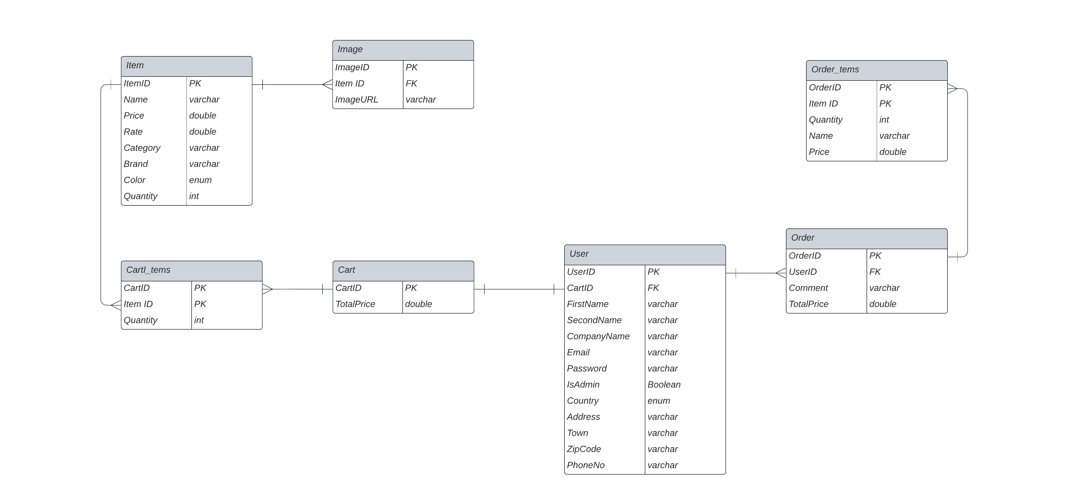

Slide 7
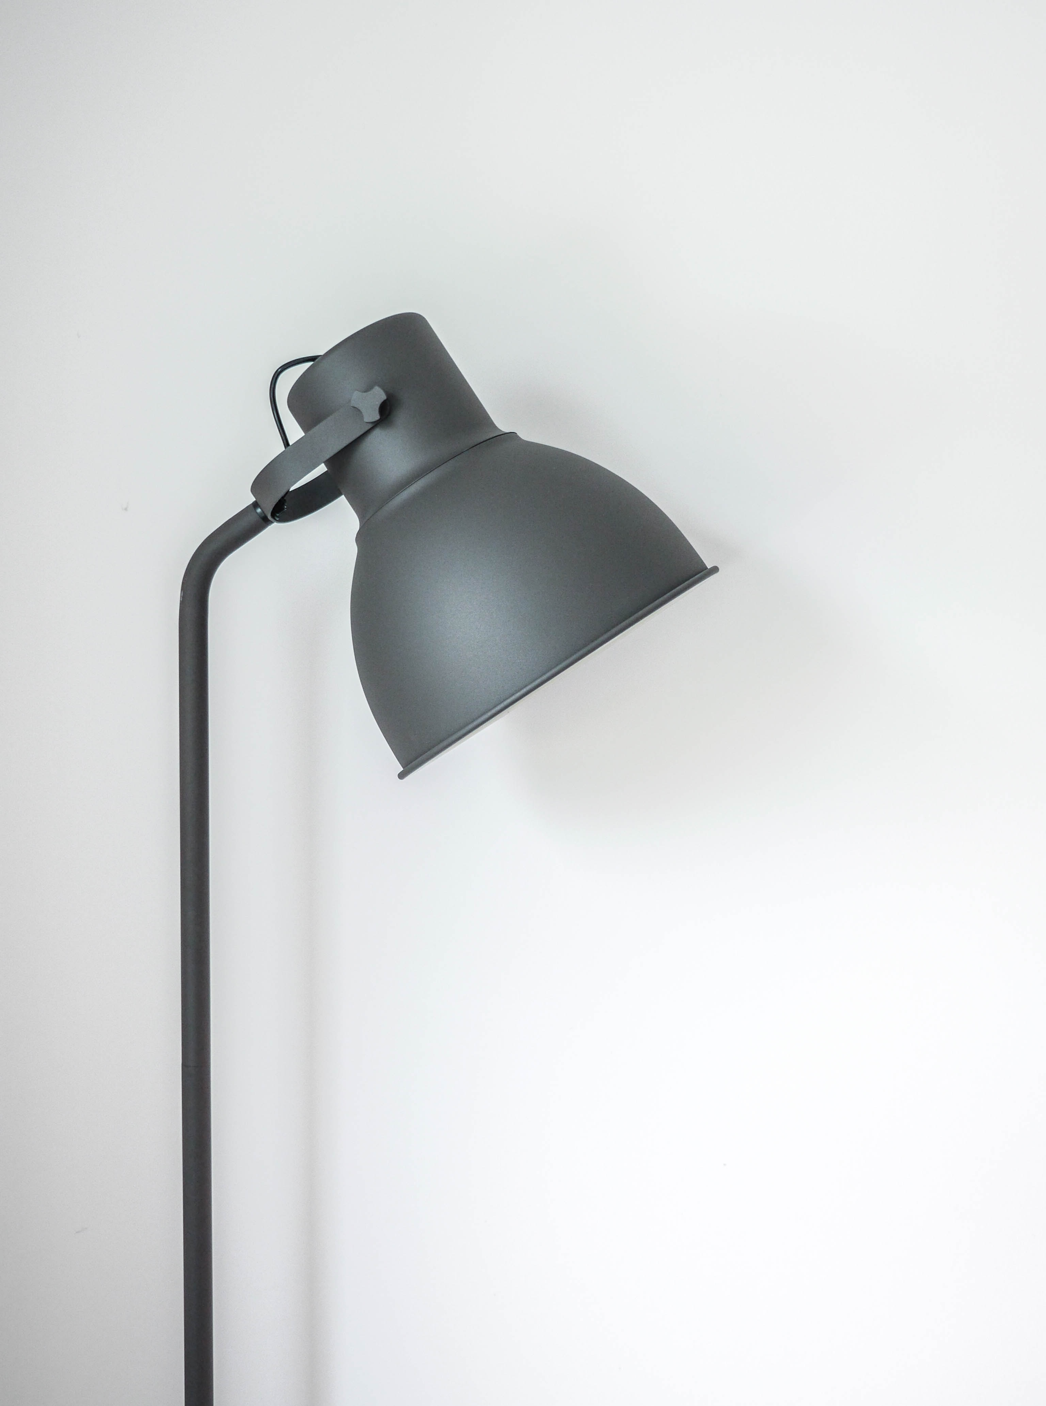
03
Demo

Slide 8
HOME

Slide 9
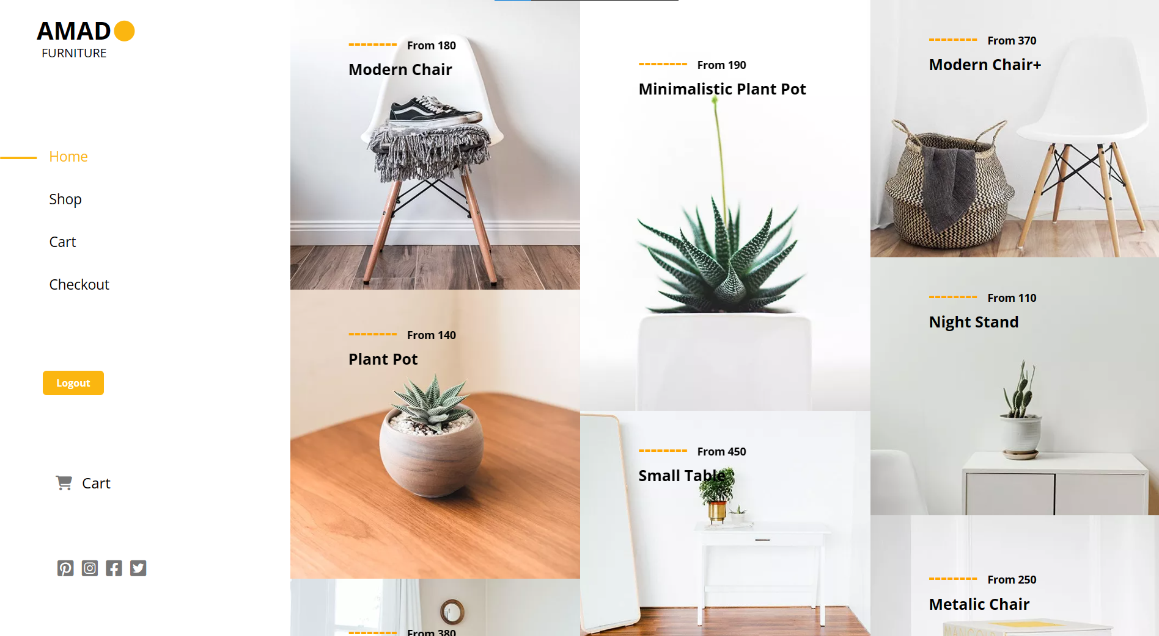

Slide 10
SHOP

Slide 11
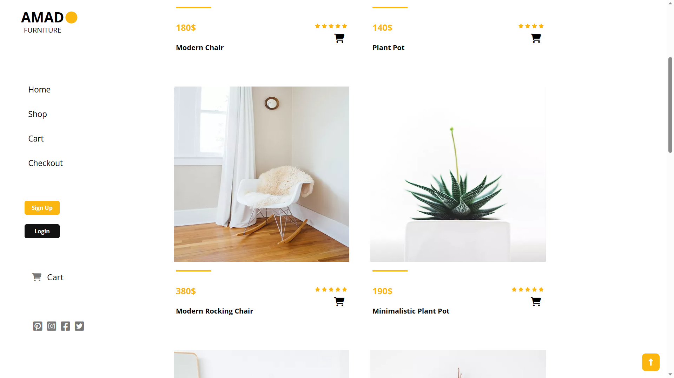

Slide 12
PRODUCT

Slide 13
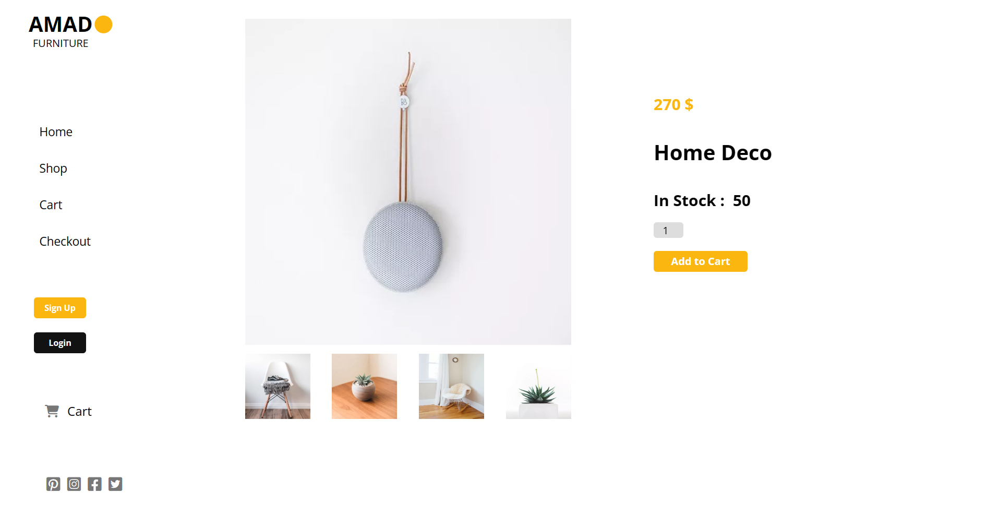

Slide 14
SIGNUP

Slide 15
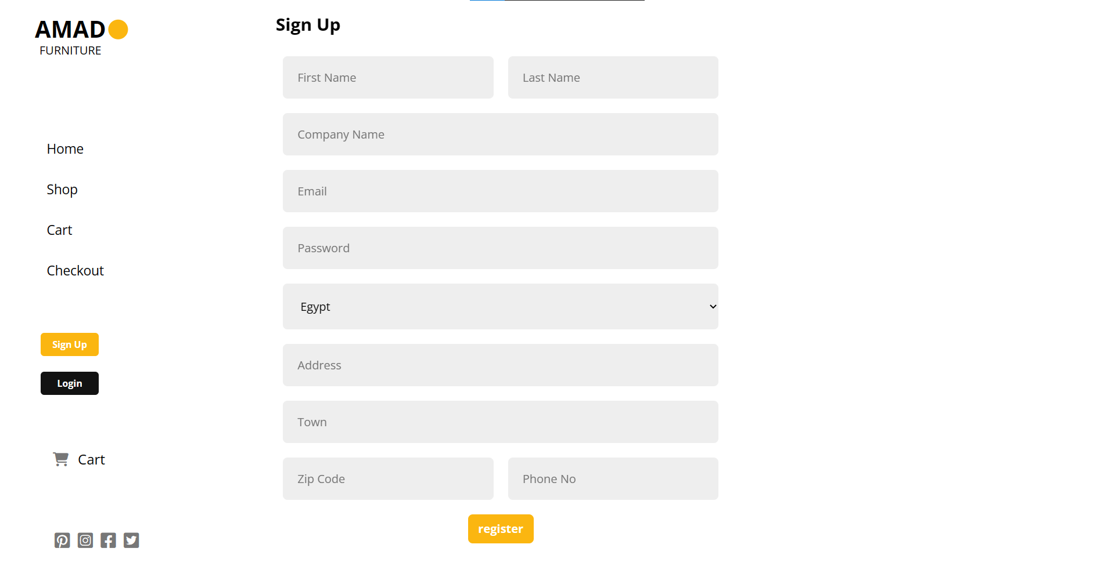

Slide 16
LOGIN

Slide 17
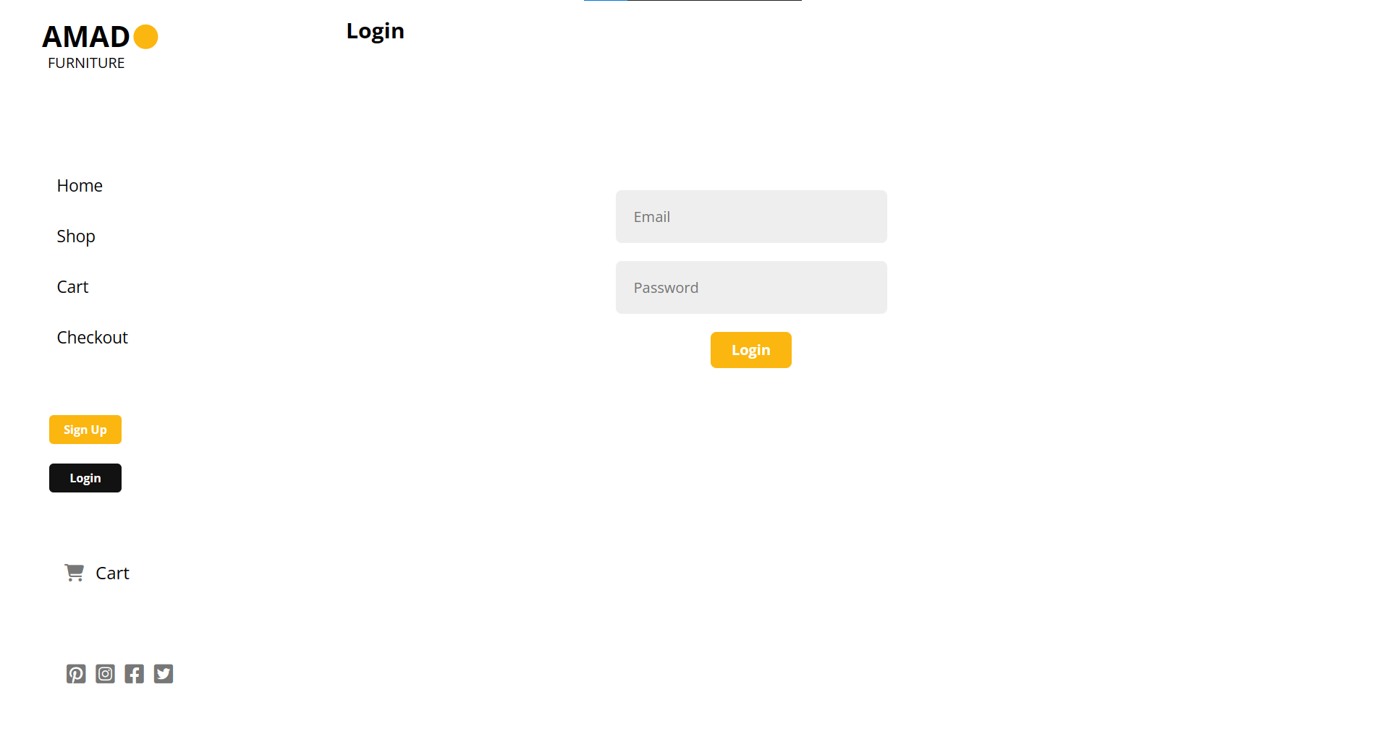

Slide 18
CART

Slide 19
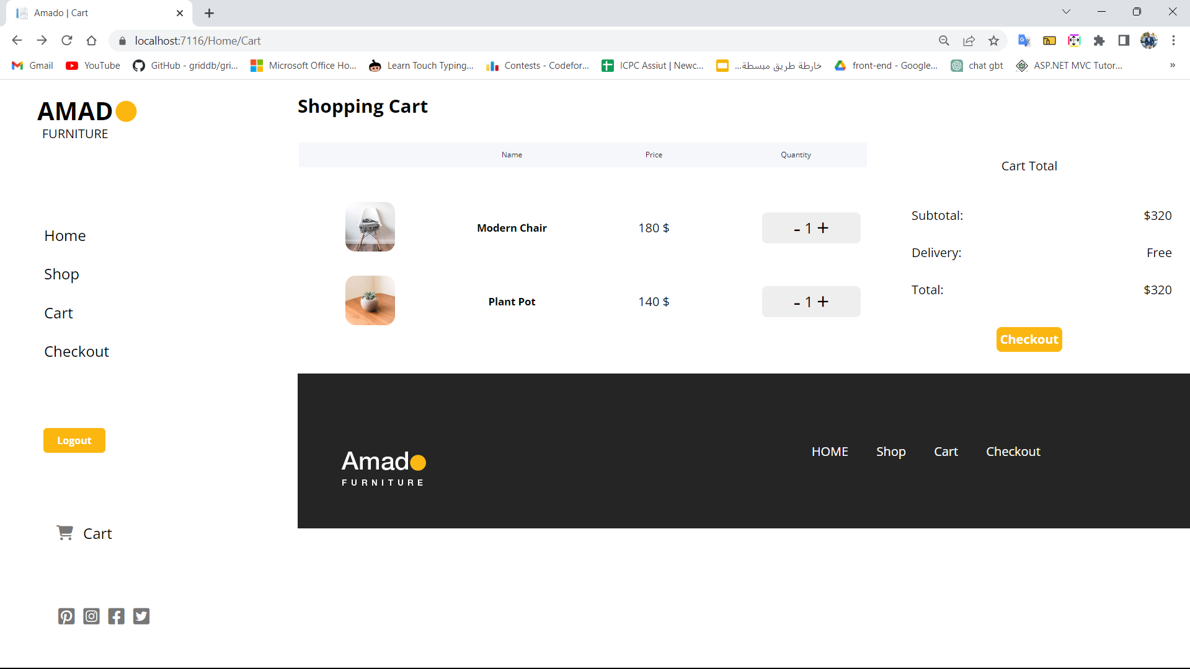

Slide 20
CHECKOUT

Slide 21
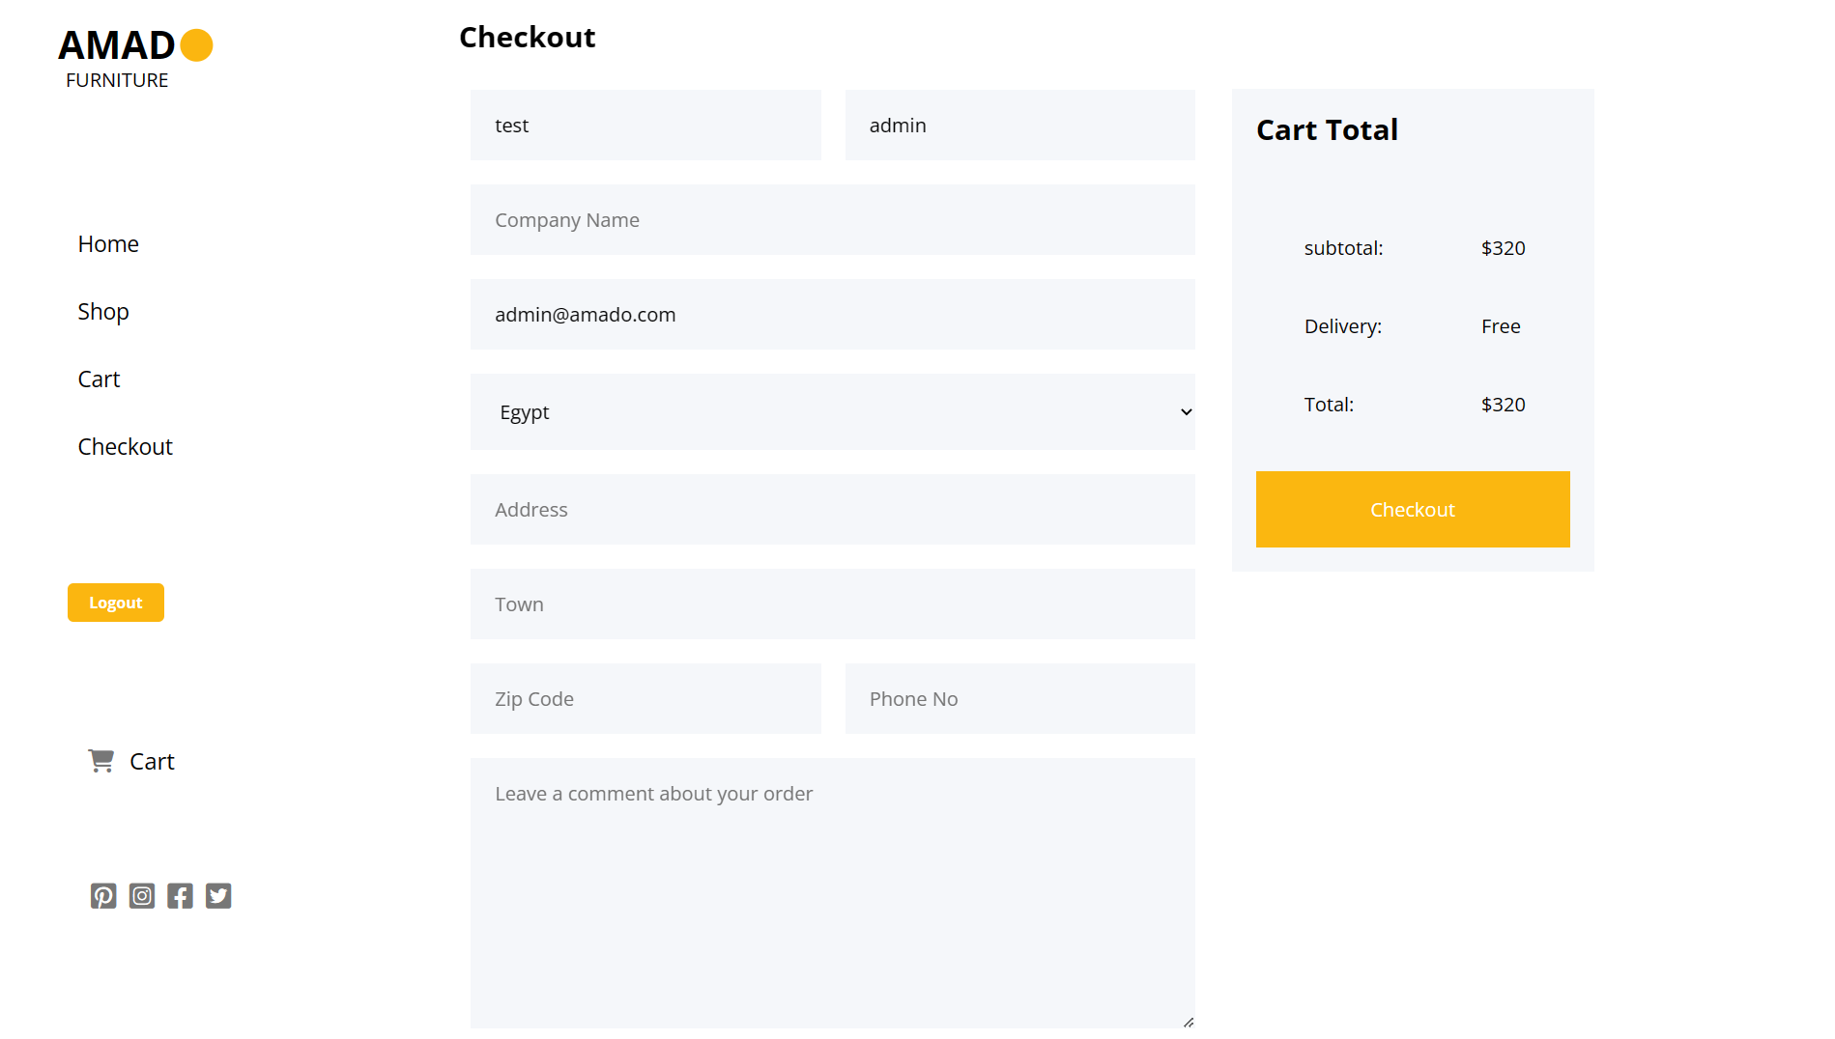

Slide 22
ADMIN

Slide 23
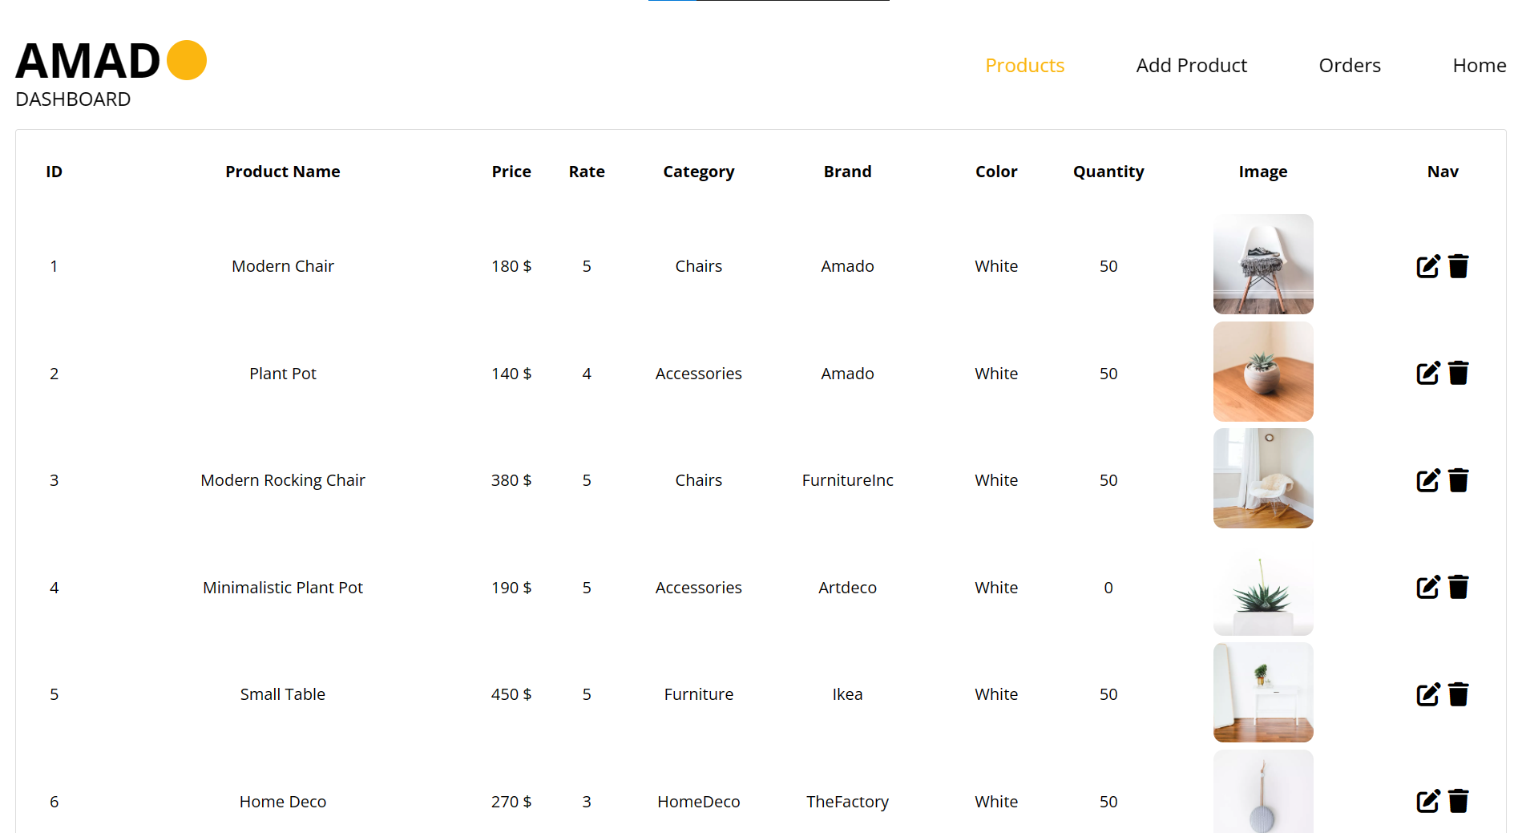

Slide 24
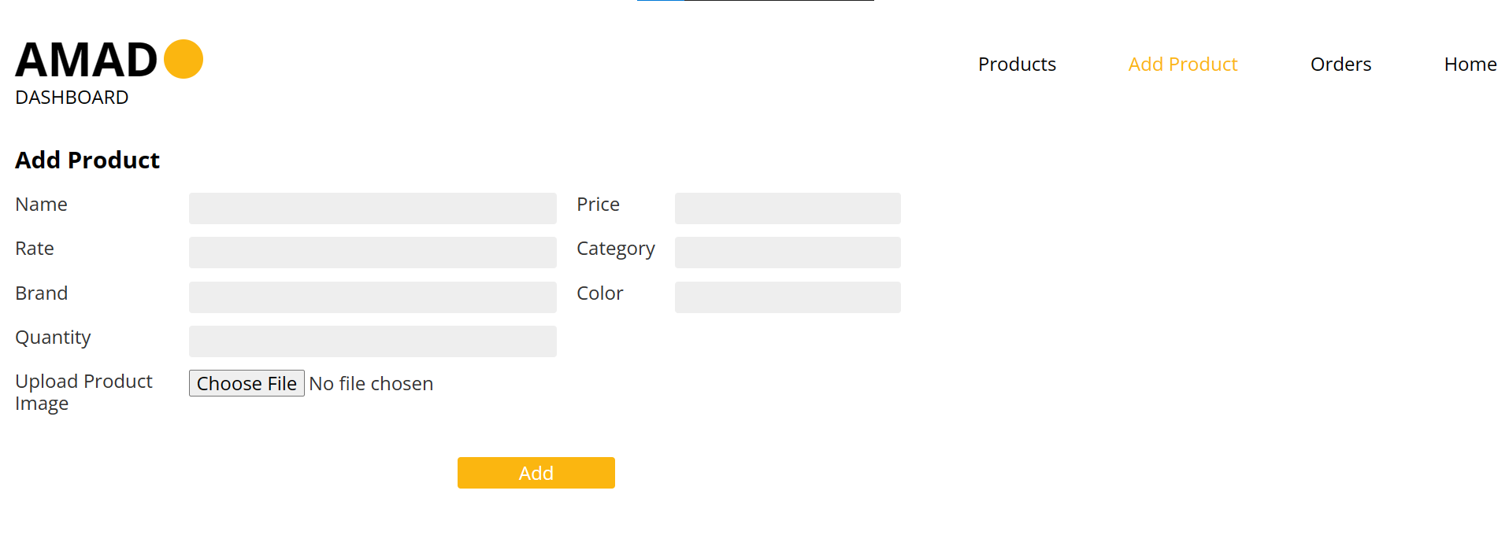

Slide 25
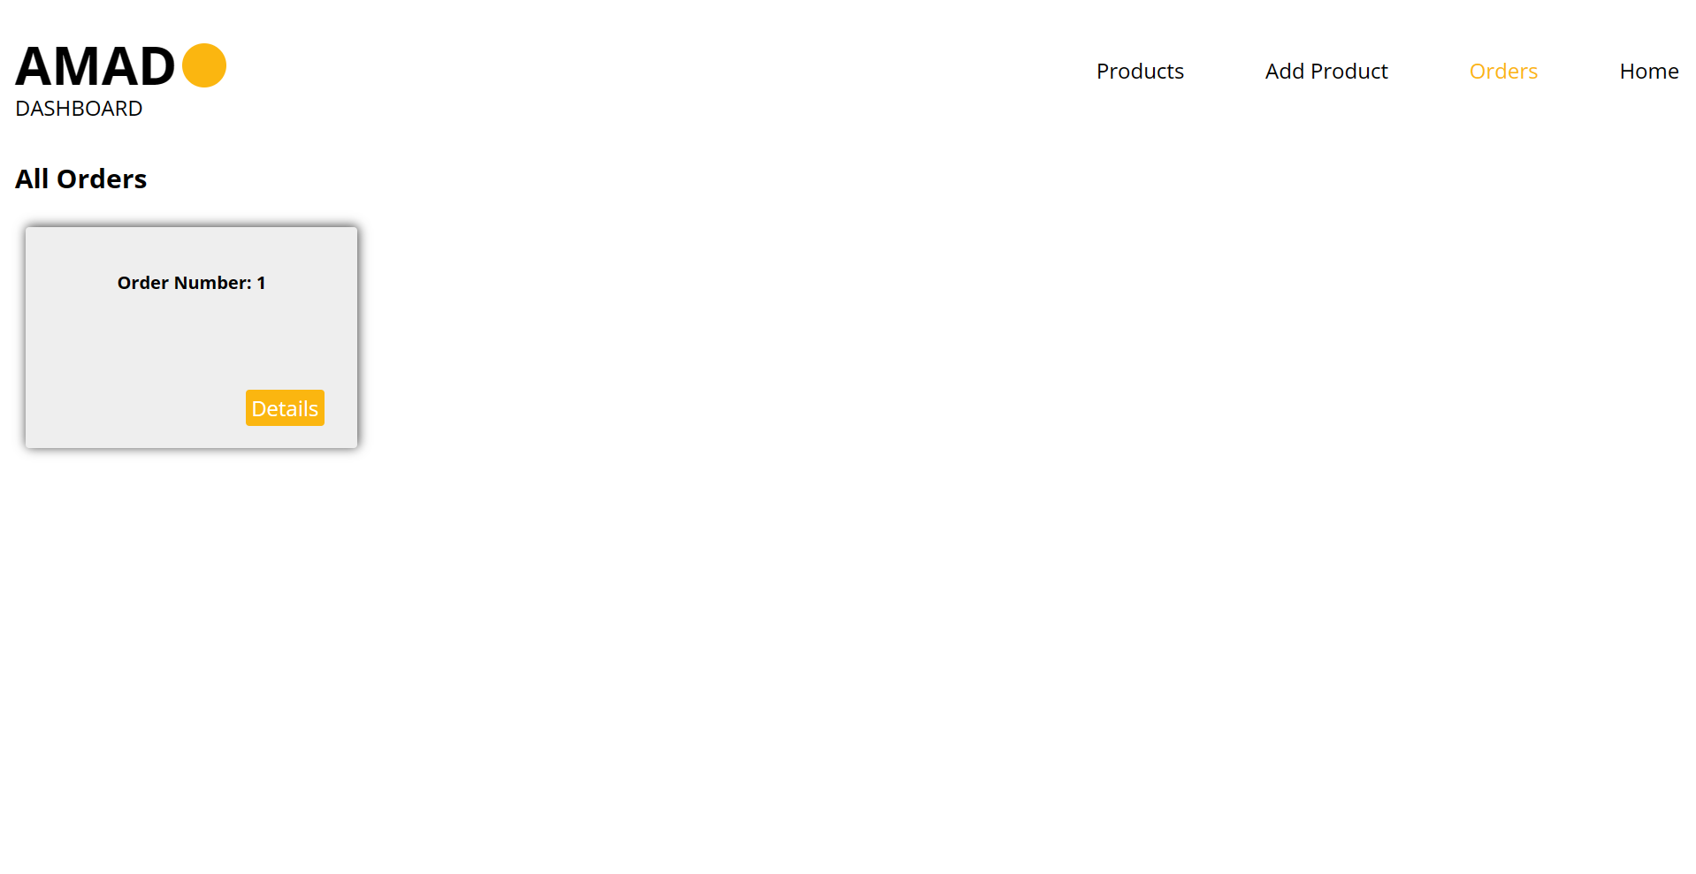

Slide 26
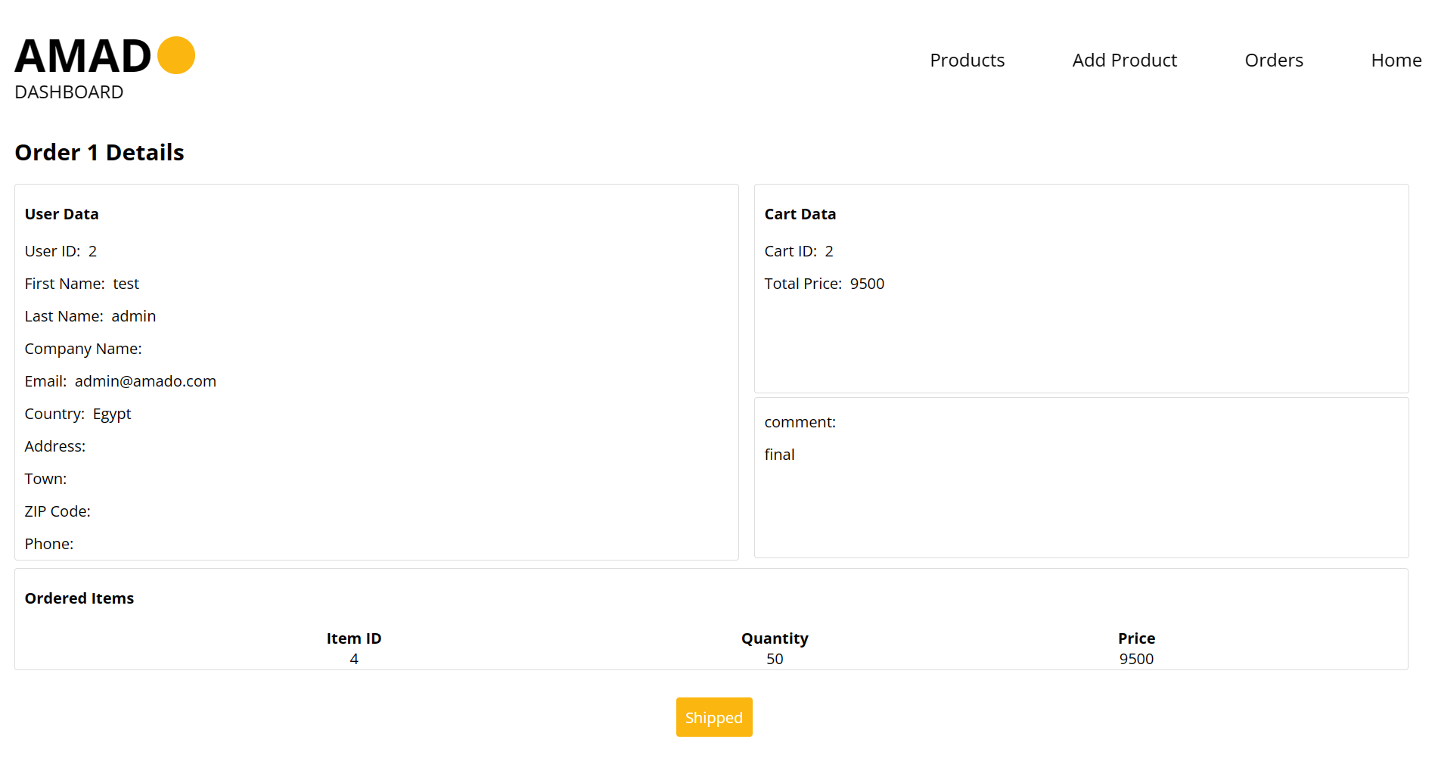

Slide 27
Amado
THANK YOU

